Slide 1
Cloud Computing
IT resources provided as a service
Compute, storage, databases, queues
Clouds leverage economies of scale of commodity hardware
Cheap storage, high bandwidth networks & multicore processors
Geographically distributed data centers
Offerings from Microsoft, Amazon, Google, …

Slide 3
Benefits
Cost & management
Economies of scale, “out-sourced” resource management
Reduced Time to deployment
Ease of assembly, works “out of the box”
Scaling
On demand provisioning, co-locate data and compute
Reliability
Massive, redundant, shared resources
Sustainability
Hardware not owned

Slide 4
Types of Cloud Computing
Public Cloud: Computing infrastructure is hosted at the vendor’s premises.
Private Cloud: Computing architecture is dedicated to the customer and is not shared with other organisations.
Hybrid Cloud: Organisations host some critical, secure applications in private clouds. The not so critical applications are hosted in the public cloud
Cloud bursting: the organisation uses its own infrastructure for normal usage, but cloud is used for peak loads.
Community Cloud

Slide 5
Classification of Cloud Computing based on Service Provided
Infrastructure as a service (IaaS)
Offering hardware related services using the principles of cloud computing. These could include storage services (database or disk storage) or virtual servers.
Amazon EC2, Amazon S3, Rackspace Cloud Servers and Flexiscale.
Platform as a Service (PaaS)
Offering a development platform on the cloud.
Google’s Application Engine, Microsofts Azure, Salesforce.com’s force.com .
Software as a service (SaaS)
Including a complete software offering on the cloud. Users can access a software application hosted by the cloud vendor on pay-per-use basis. This is a well-established sector.
Salesforce.coms’ offering in the online Customer Relationship Management (CRM) space, Googles gmail and Microsofts hotmail, Google docs.

Slide 6
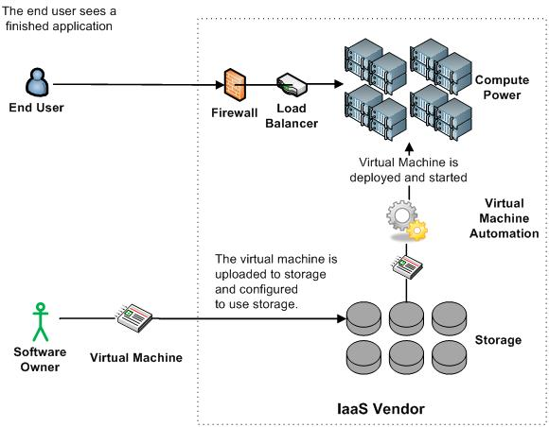
Infrastructure as a Service

Slide 7
More Refined Categorization
Storage-as-a-service
Database-as-a-service
Information-as-a-service
Process-as-a-service
Application-as-a-service
Platform-as-a-service
Integration-as-a-service
Security-as-a-service
Management/
Governance-as-a-service
Testing-as-a-service
Infrastructure-as-a-service

Slide 8
Key Ingredients in Cloud Computing
Service-Oriented Architecture (SOA)
Utility Computing (on demand)
Virtualization (P2P Network)
SAAS (Software As A Service)
PAAS (Platform AS A Service)
IAAS (Infrastructure AS A Servie)
Web Services in Cloud

Slide 9
Enabling Technology-Virtualization
App
App
App
App
App
App
OS
OS
OS
Operating System
Hypervisor
Hardware
Hardware
Traditional Stack
Virtualized Stack

Slide 10
Everything As a Service
Utility computing = Infrastructure as a Service (IaaS)
Why buy machines when you can rent cycles?
Examples: Amazon’s EC2, Rackspace
Platform as a Service (PaaS)
Give me nice API and take care of the maintenance, upgrades, …
Example: Google App Engine
Software as a Service (SaaS)
Just run it for me!
Example: Gmail, Salesforce

Slide 11
Cloud vs Cloud
Amazon Elastic Compute Cloud
Google App Engine
Microsoft Azure
GoGrid
AppNexus

Slide 12
Cloud and Big Data
Features of Cloud Computing that can be useful to handle Big Data:
On Demand Self Service
Broad Network Access
Resource Pooling
Rapid Elasticity
Measured Service

Slide 13
Crowdsourcing
Wisdom of Crowd
The crowd at a county fair accurately guessed the weight of an ox when their individual guesses were averaged (the average was closer to the ox's true butchered weight than the estimates of most crowd members, and also closer than any of the separate estimates made by cattle experts).

Slide 14
What is Crowdsourcing
Crowdsourcing is an online, distributed problem solving and production model.
Users--also known as the crowd--typically form into online communities based on the Web site, and the crowd submits solutions to the site or produce its contents.
The crowd can also sort through the solutions, finding the best ones.
These best solutions are then owned by the entity that broadcast the problem in the first place--the crowdsourcer
The winning individuals in the crowd are sometimes rewarded.
Many individuals in the crowd participate just for intellectual stimulation or because of emotional ties to product or service

Slide 15
Benefits of Crowdsourcing
Problems can be explored at comparatively little cost.
Payment is by results.
The organization can tap a wider range of talent than might be present in its own organization
Turn customers into designers
Turn customers into marketers

Slide 16
Problems of Crowdsourcing
Quality
Intellectual property leakage
No time constraint
Not much control over development or ultimate product
Ill-will with own employees
Choosing what to crowdsource & what to keep in-house

Slide 17
Some Applications
Testing & Refining a Product
Netflix
SellaBand
Market Research
Threadless
Knowledge Management
Accenture
Wikipedia
Customer Service
My Starbucks ideas
R & D
InnoCentive
P&G Connect & Develop
Polling and Voting
InTrade
Building a new city

Slide 18
Mobile Business Intelligence
MBI is software that extends desktop Business Intelligence applications so they can be used on a mobile device. MBI Applications optimizes traditional BI Reports so they can be viewed easily on a small screen and is ideal for displaying key performance indicators (KPIs) and alerts on small screens with simple charts, graphs and sparklines. It allows data that is captured by the mobile device to be integrated on-the-fly so that reports are currents and mobile workers can make informed decisions in real time.

Slide 19
Features
Analytics
•Exploration and Manipulation
•Offline Analysis
•Grids and Graphs
•Touch-optimized controls
•Advanced data visualizations
•Interactive OLAP
•Data-driven Alerting
•User Scale
•Data Scale
•Performance

